Slide 1


Slide 2

Home page
https://www.dartlang.org/

Slide 3
History
Dart was unveiled at the GOTO conference in Aarhus, Denmark, October 10–12, 2011.
The project was founded by Lars Bak and Kasper Lund

Slide 4
First stable version
In November 2013, the first stable version, Dart 1.0 was released.

Slide 5
Who use??
https://www.dartlang.org/community/who-uses-dart

Slide 6
Dart News and Updates
AngularDart 4 - September 5, 2017
Pre-releases of Dart 2.0: what they mean to you - September 25, 2017
Dart 2: Optimized for Client-Side Development - February 22, 2018

Slide 7


Slide 8
Twitter
https://twitter.com/dart_lang

Slide 9
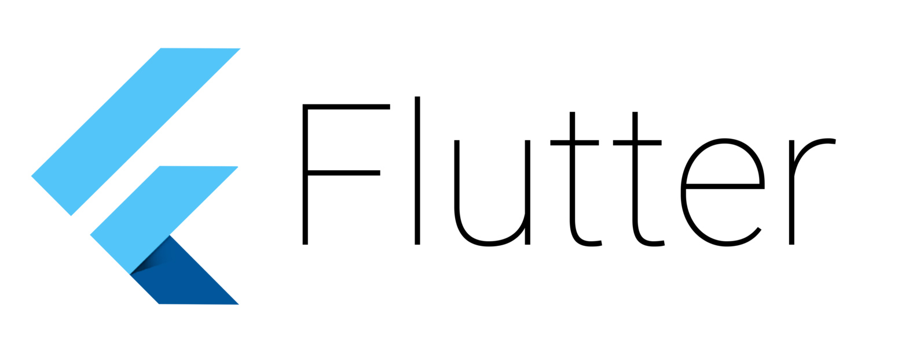

Slide 10

Contextualizing
https://hackernoon.com/whats-revolutionary-about-flutter-946915b09514

Slide 11
4 ways Flutter makes mobile app development delightful
https://opensource.com/article/18/6/flutter

Slide 12
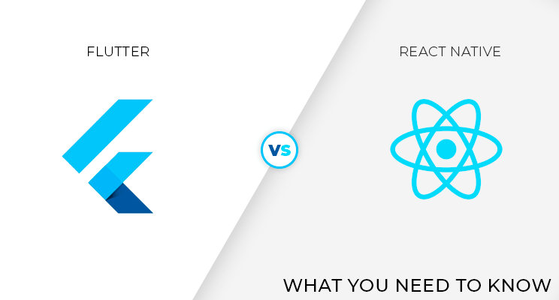
Flutter vs React Native

Slide 13
Flutter vs React Native
https://medium.com/@openGeeksLab/flutter-vs-react-native-what-you-need-to-know-89451da3c90b
https://blog.novoda.com/react-native-flutter-xamarin-a-comparison/
https://www.quora.com/What-is-the-best-flutter-or-react-native

Slide 14
Flutter
https://flutter.io/
https://flutter.io/get-started/install/
https://flutter.io/faq/

Slide 15
Flutter Support
https://gitter.im/flutter/flutter
Community support and Google Flutter engineers

Slide 16
Flutter Channel
Flutter Challenge
https://bit.ly/2LRtQGT
Brandon Donnelson
https://bit.ly/2Ma1ULj

Slide 17
Flutter Channel
Tensor Programming
https://bit.ly/2O1SVMF
Bram Vanbilsen
https://www.youtube.com/channel/UCqibwXKXYPpnPuo5xg5l2xA

